Slide 1
Intro To C++
CPSC 2320 L0
2020-09-03

Slide 2
Lecture outline
How does C++ work?
Basic syntax
Data types and variable declaration
Arithmetic
Installing a C++ compiler and Eclipse

Slide 3
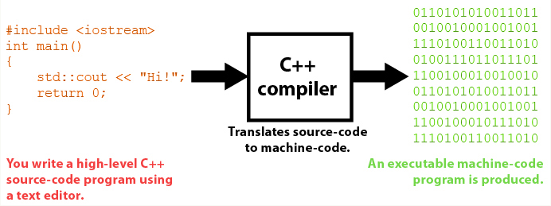
HOW does c++ Work?
Computers fundamentally can only read machine language
Sequences of binary numbers providing instructions
A C++ compiler translates C++ source code into machine-readable executables
Notes:
Machine code is directly read by the computer
Assembly code is human readable and maps text commands to binary ones. Still machine-dependent.
Compiler translates
xxd -b add_nums | more
gdb add_nums; disas main

Slide 4
HOW does c++ Work?
Because C++ source code is independent of machine type, we call it a high level language
Notes:
Machine and assembly: same operation = different code
C++: same operation, same code
High level

Slide 5
HOW does c++ Work?
C++ is very similar to its predecessor, C
Unlike C, C++ is object oriented
More on this later in the semester…

Slide 6
C++ VS Python
Python is an interpreted language
Code is read and translated at runtime
Can have syntax errors at runtime
C++ is translated/compiled before running the program
Syntax errors are found during compilation (before running)
Run: executable file is loaded into memory, then executed

Slide 7

C++ VS Python
Python is optimized for ease of use and fast program writing
C++ is optimized for fast program execution
A C++ program will run somewhere from 3 to 300+ times faster than the same program running in Python

Slide 8
USES of C++
Working with large datasets
Live interactions with hardware
Many browsers and operating systems are built with C++
Is speed important? And/or is direct control over computer resources important?
C++ is a good solution
Smaller program? Speed not an issue? Need a solution written quickly?
Python, etc…

Slide 9
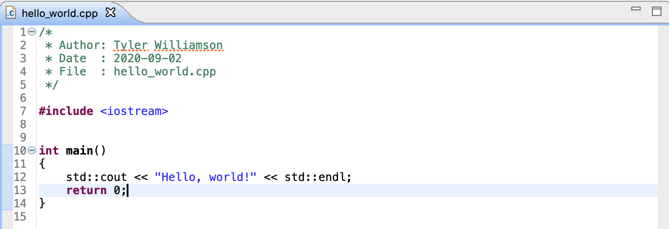
Hello World

Slide 10
Hello World
#include <iostream>
We want to use the functions and variables declared in the “iostream” library (allows us to print to the console)

Slide 11
Hello World
int main()
Declares a function in C++
Only code inside of main will be executed

Slide 12
Hello World
std::cout << “Hello, world!” << std::endl;
cout (stands for C-out, or C-output): prints to the console
The std:: prefix tells the program where the cout statement lives
std is a “namespace”, (an identifier used to look for prewritten functions/classes”
cout << “text”: passes “text” to the cout stream

Slide 13
Hello World
return 0;
The function is of type int so it must return an int
return 0→program exited cleanly

Slide 14
Hello World
//this is a comment
/*this is a multi line
Comment*/

Slide 15
Hello World
Notice!
Function code is in between {}
Every statement terminated by ;

Slide 16
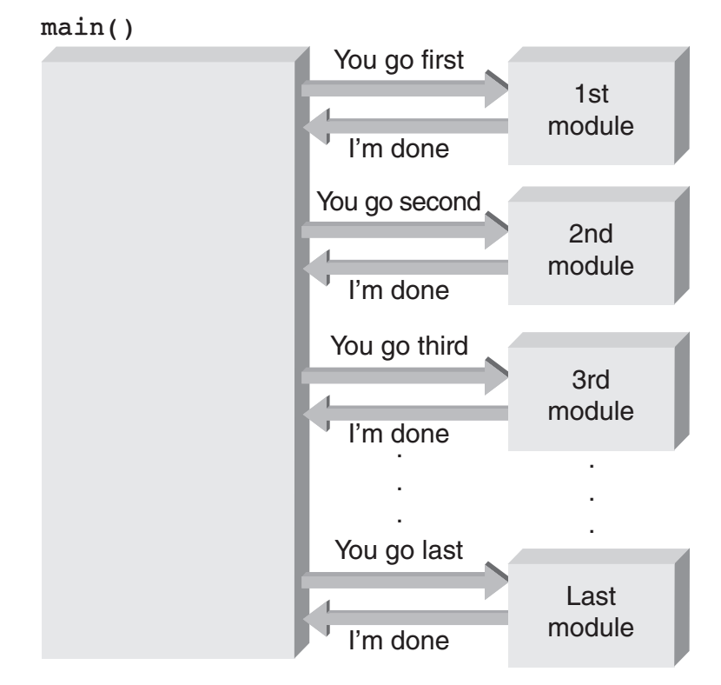
Main()
Main is the entry point to the entire program
Every program must have exactly one function called main of type int
Main can (and often does) call other functions, either from the same file or a different one

Slide 17
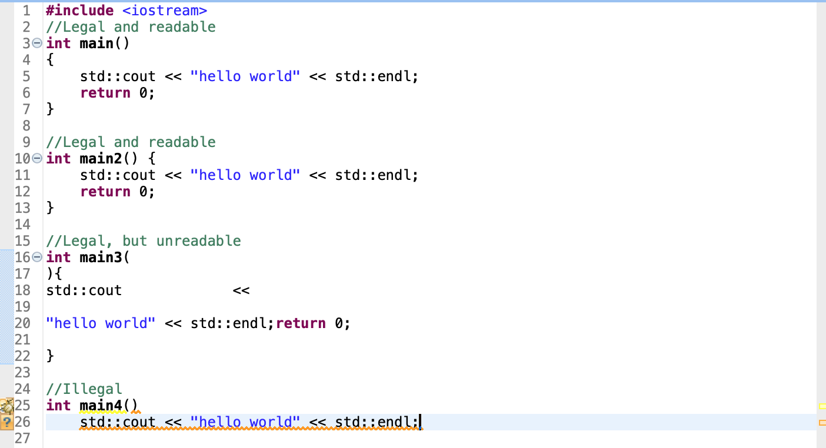
A note on style
Most commonly used
Just be consistent

Slide 18
Declaring and using variables
Examples:
double pi;
int numStudents = 15;
double euler{2.71828};

Slide 19
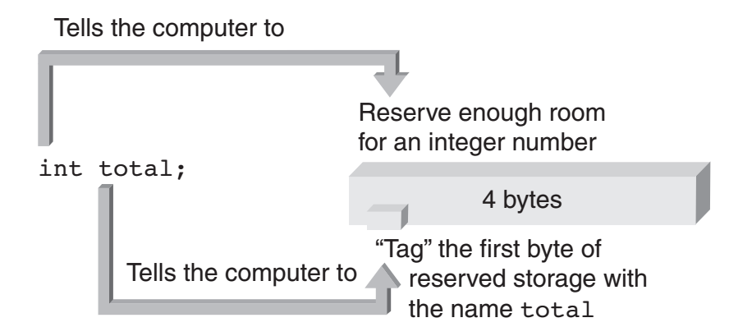
Declaring and using variables
Why do we need to declare variables?
How C++ interacts with the computer’s memory
<datatype> <variable name>; //optional, initialize with an =;
int number = 3;
How much
memory do we need?
How do we refer to the
memory address?
What value should we
store there?

Slide 20
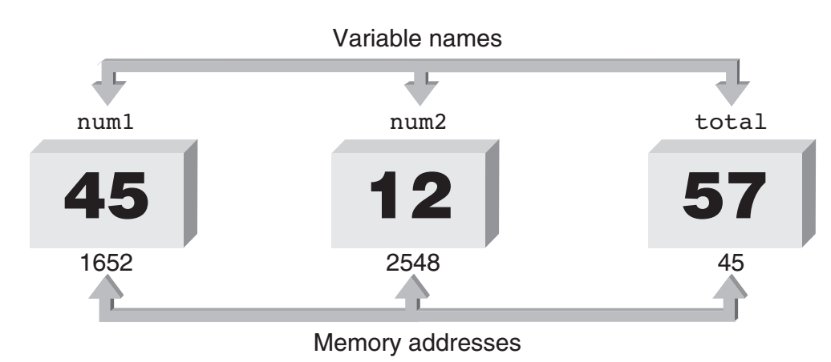
Declaring and using variables
int num1 = 45;
“reserve a block of memory big enough for an int type (4 bytes), associated the memory address with the name `num1’, and store the interger 45 there”
int num2 = 12;
int total = num1+num2;
“reserve block of memory and call it `total’. Store inside the sum of the contents of the memory associated with `num1’ and `num2’”

Slide 21
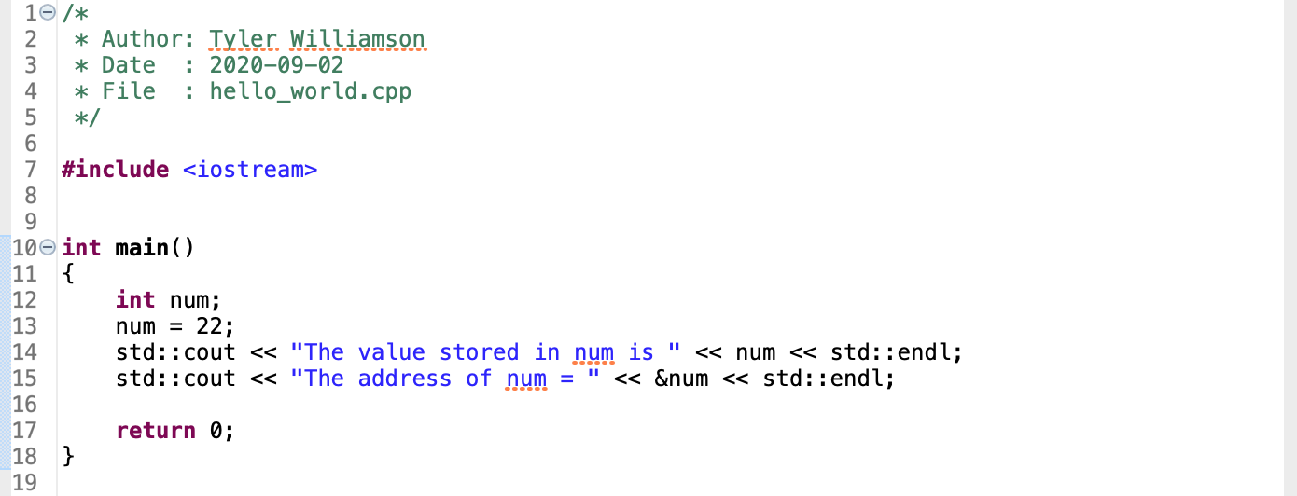
Access memory address of a variable
“The value stored in num is 22
The address of num = 0x7ffee636b518”

Slide 22
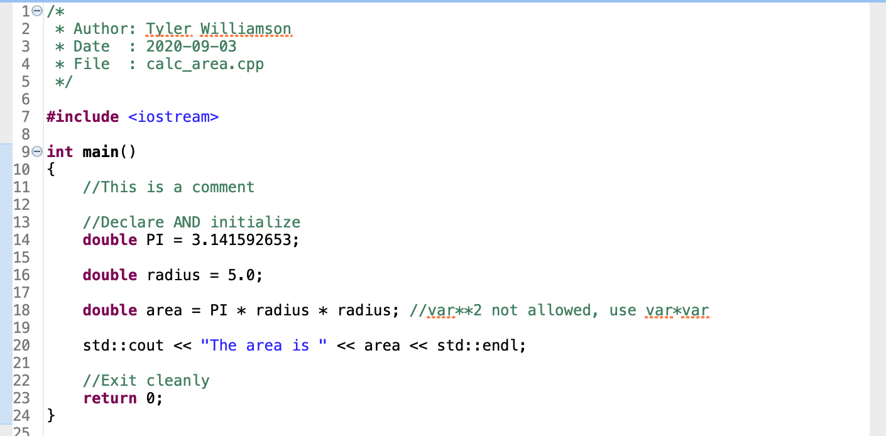
Another Example: Area of a circle

Slide 23
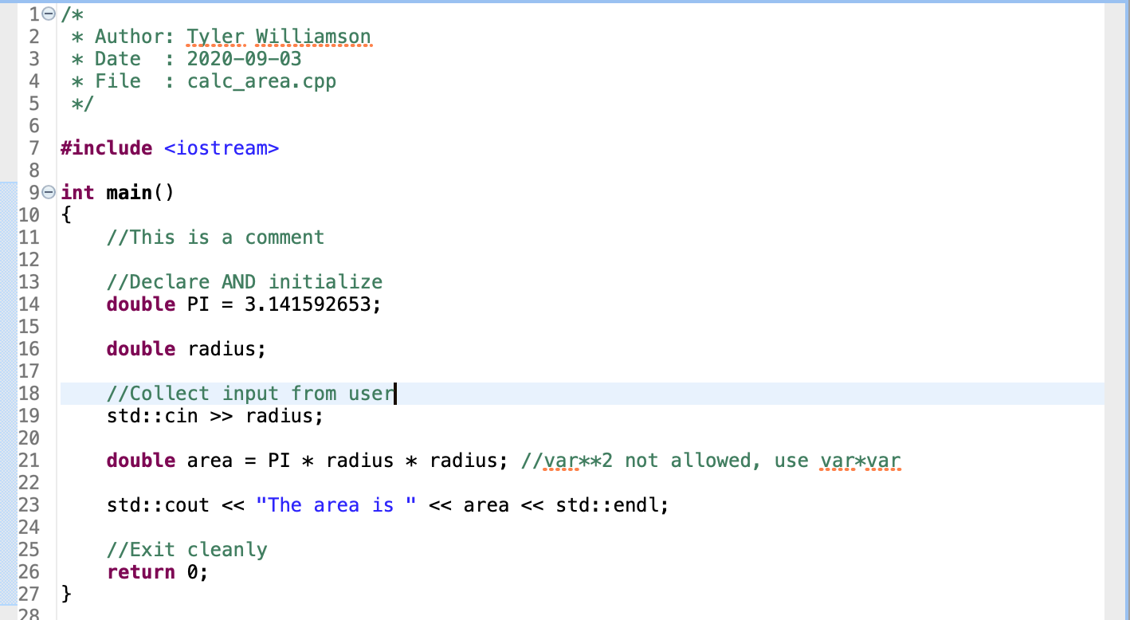
Another Example: Area of a circle
Can collect user input with cin (C-in, C-input)

Slide 24
Casting variables
double myvar = 3.14;
int myvar2 = (int) myvar; //Explicit casting
int myvar2 = myvar; //Implicit casting
Implicit casting can lead to unexpected results!
Notes:
Example

Slide 25

Exercise: Radar speed trap
Outgoing frequency: $f_{e}$
Returning frequency: $f_{r}$
Car speed: $v=6.685×{10}^{8}\left(\frac{f_{r}−f_{e}}{f_{r}+f_{e}}\right)$
Write a program that calculates the velocity and prints it
User inputs the frequencies
Notes:
fe = 2e10
fr = 2.000004e10

Slide 26
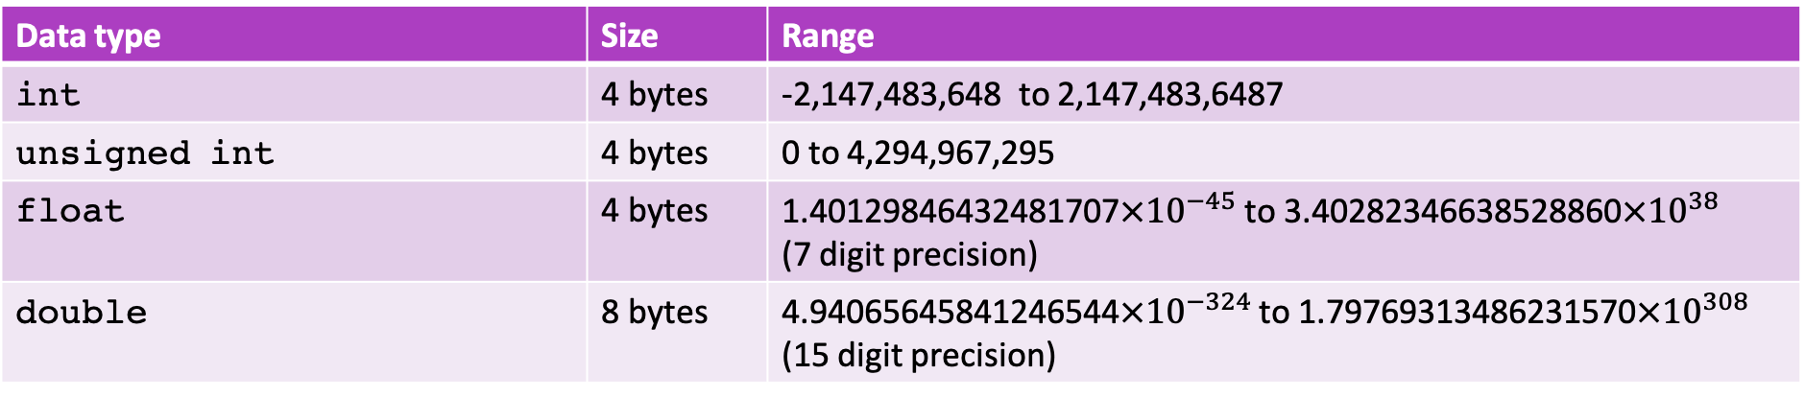
C++ Data types
Data type | Size | Range
int | 4 bytes | ﻿-2,147,483,648 to 2,147,483,6487
unsigned int | 4 bytes | 0 to ﻿4,294,967,295
float | 4 bytes | ﻿1.40129846432481707$×{10}^{−45}$ to ﻿﻿3.40282346638528860$×{10}^{38}$ (7 digit precision)
double | 8 bytes | ﻿4.94065645841246544$×{10}^{−324}$ to ﻿1.79769313486231570$×{10}^{308}$ (15 digit precision)

Slide 27
C++ Math Operations
addition +
subtraction -
multiplication *
division /
Danger: unintentional integer division! 1 / 2 = 0
modulus %
Gives the remainder:
8 % 2 = 0
10 % 3 = 1
7 % 10 = 7

Slide 28
C++ Math Operations
Special (not allowed in Python) operators:
increment ++
x++ is equivalent to x = x + 1
decrement --
x-- is equivalent to x = x - 1
Assignment operators:
+=, -=, *=, /=, %=
x += 5 is equivalent to x = x + 5

Slide 29
C++ Math Operations
”=“ is also an operator
variable = <something>
returns the value stored in “variable” after the statement finishes

Slide 30
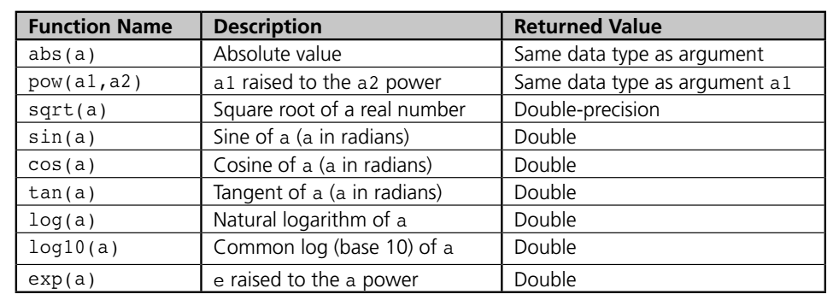
C++ Math Library
#include <cmath>
See http://www.cplusplus.com/reference/cmath/ for more functions

Slide 31
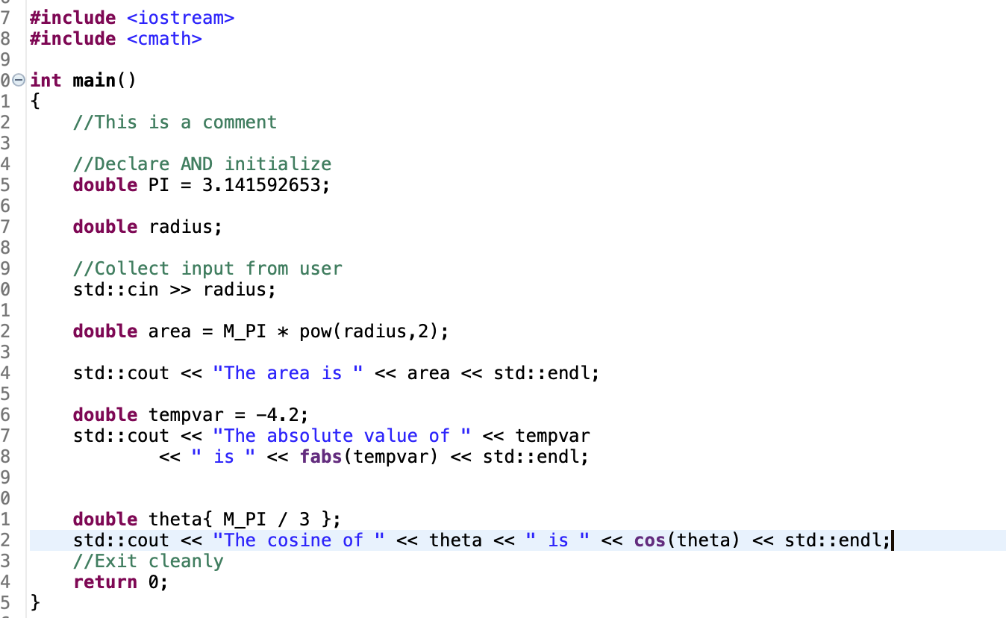
Cmath example

Slide 32
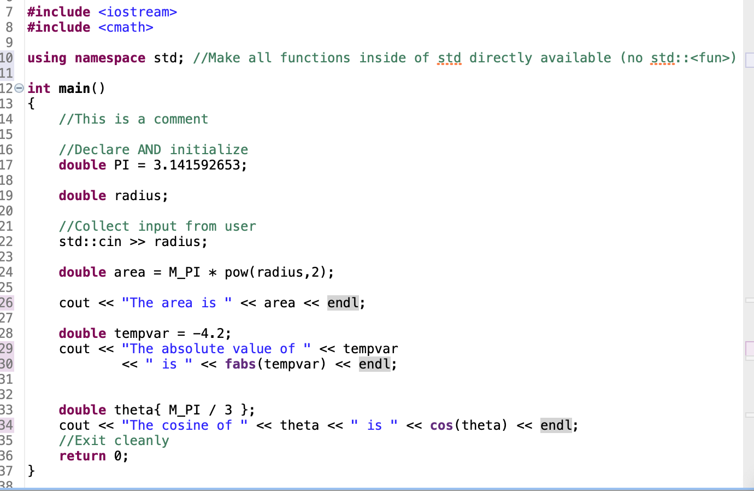
Tired of Writing std:: all the time?
using namespace std;
Be careful if using multiple namespaces
Can lead to name confusion!

Slide 33
Output with cout: #include <iomanip>
To control the formatting of output, use <iomanip> functions.
Example:
#include <iomanip>
...
cout << setprecision(1) << 3.14159 << endl;
// prints 3.1

Slide 34
Output with cout: #include <iomanip>
Manipulator | Meaning
endl | insert a newline and flush stream
fixed | used fixed decimal point in float output
left | left-align output
right | right-align output
setfill(f) | set fill character to character f
setprecision(n) | set float precision to integer n
setw(n) | set field width to integer n
showpoint | always show decimal point in float output

Slide 35

Exercise
Radioactive decay
Start with 4 kg of carbon
How much carbon is left after $t$ years?
Half life of carbon ~ 5700 years
$N\left(t\right)=N_{0}e^{{−t}/τ}$

Slide 36
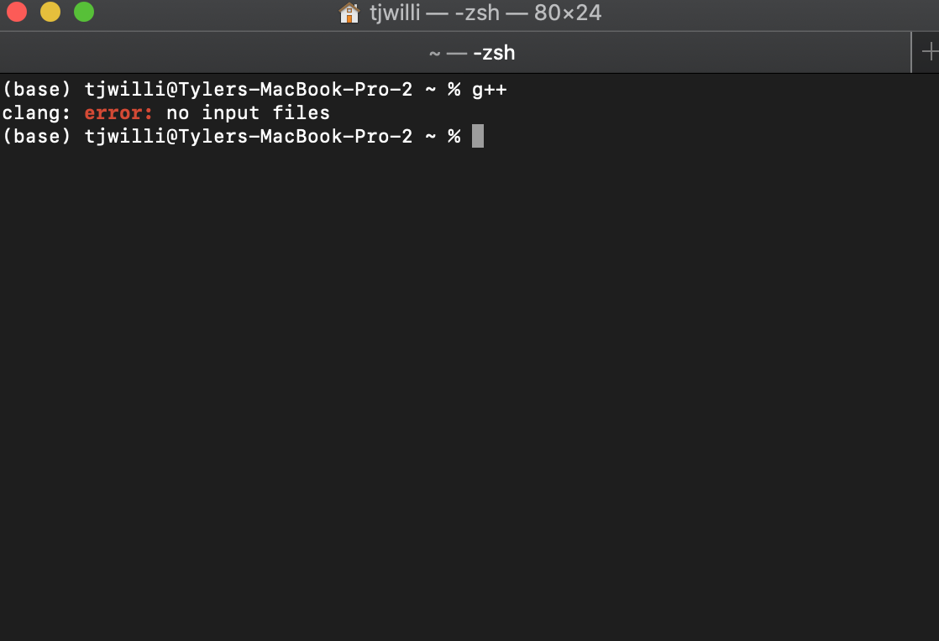
Let’s install some software!
Do you have a C++ compiler?
Open a command prompt see if any of the following work:
g++, c++, gcc, clang++

Slide 37
Install a C++ Compiler
On a Mac
Open Terminal
Run: xcode-select –install
On Windows:
Try MinGW: http://www.mingw.org/wiki/Getting_Started

Slide 38
Eclipse C++ IDE (Integrated development environment)
Download and install: https://www.eclipse.org/downloads/packages/release/2020-06/r/eclipse-ide-cc-developers
(May need a Java Development Kit)
https://www.oracle.com/java/technologies/javase-jdk14-downloads.html

Slide 39
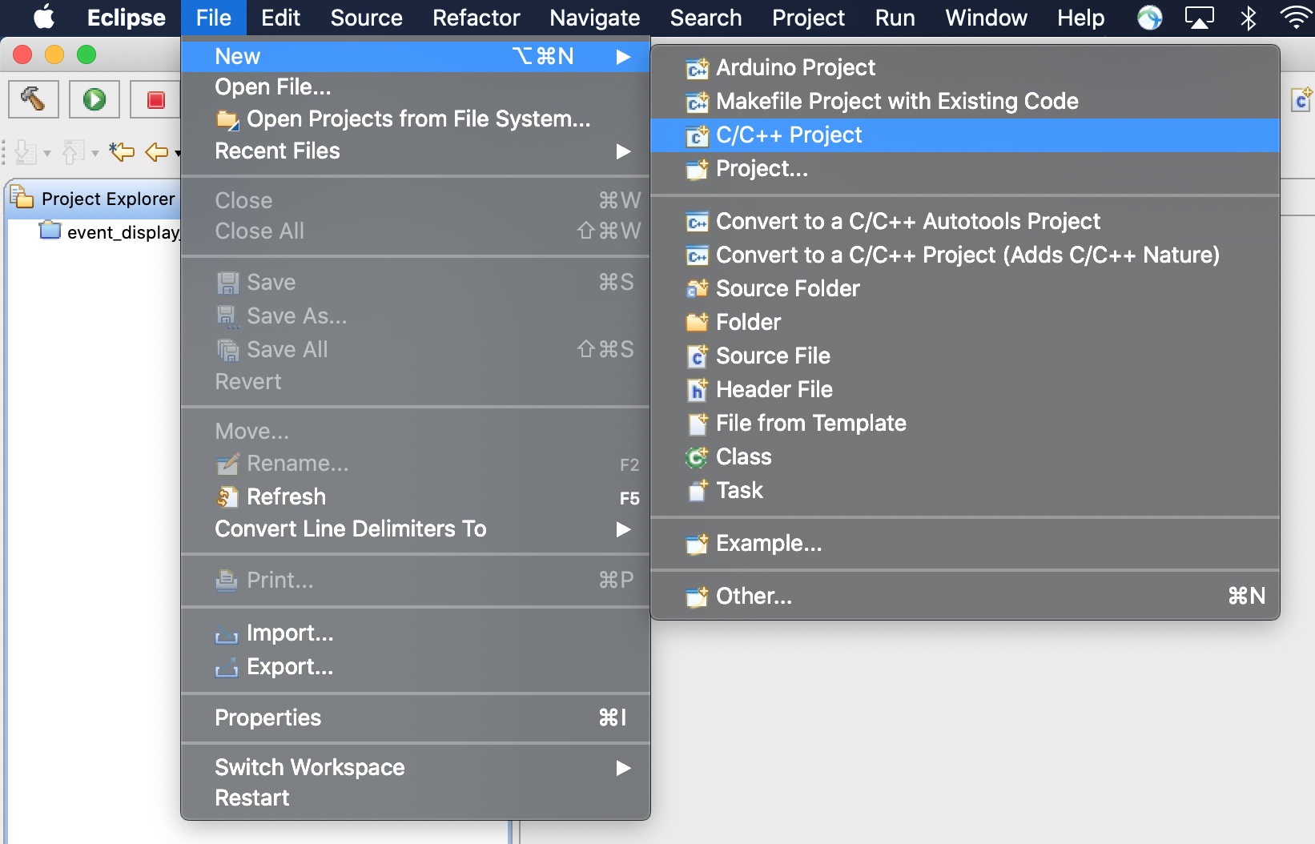
Eclipse C++ IDE (Integrated development environment)
To create a program:
File > New > C/C++ Project

Slide 40
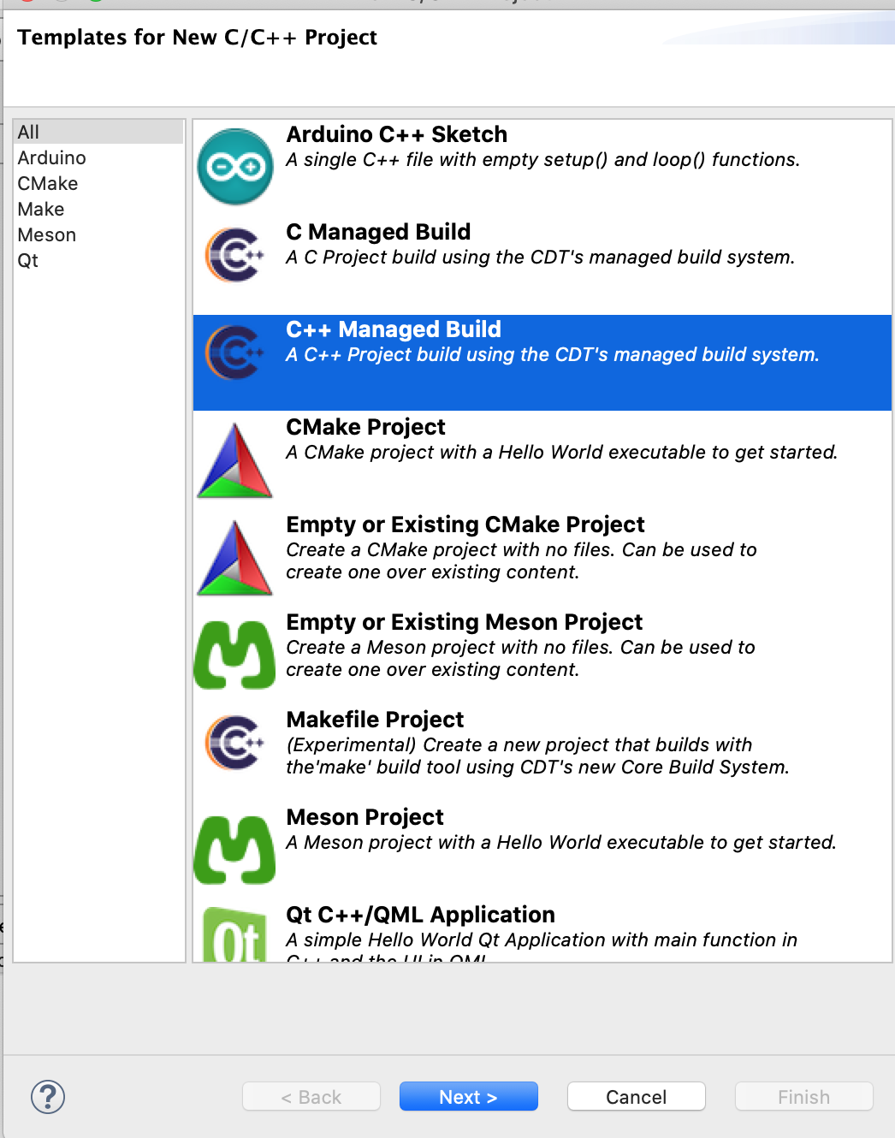
Choose C++ Managed Build and enter project name
Click “Next” under Select Configurations

Slide 41
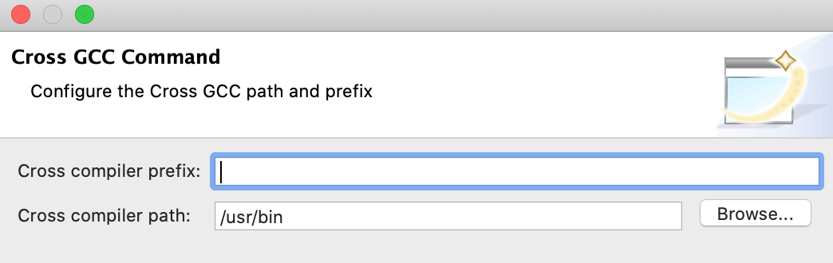
Anything (besides filepath)
that precedes g++/c++/gcc
in the name of the command
Ex: mingw-g++, prefix=mingw-
Usually nothing for Mac/Linux
Path to compiler: which g++ (Mac/Linux)
Probably C:\MinGW\bin for Windows

Slide 42
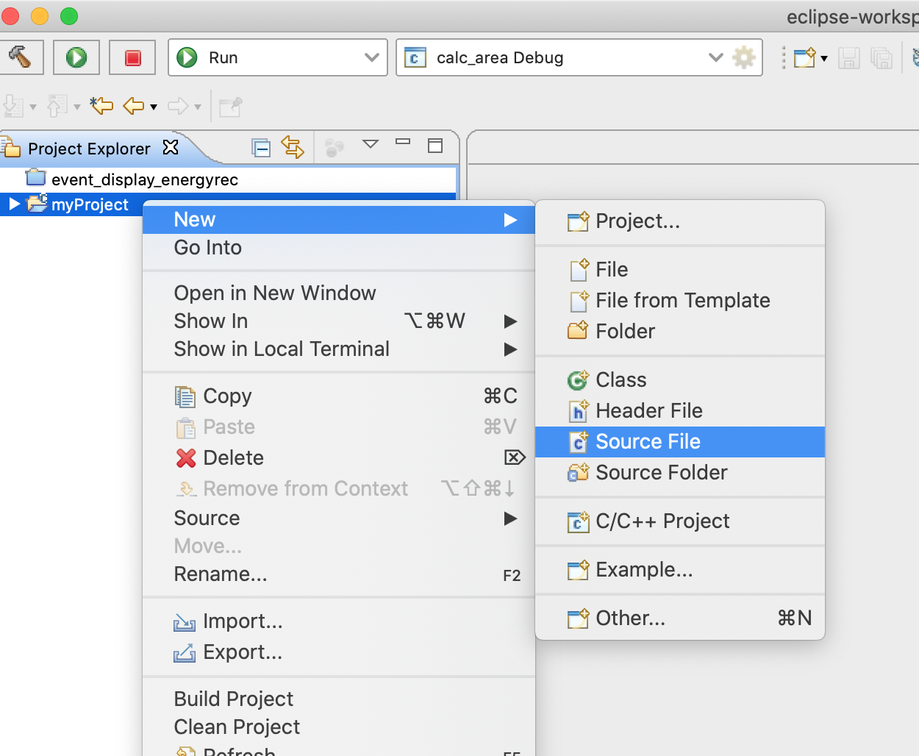
Eclipse C++ IDE (Integrated development environment)
To add a source file:
Right-click > New > Source File
Enter file name
Use extension .cpp
Template→<None>
Finish

Slide 43
Building and Running
To Build a project
Right-click on project > Build Project

Slide 44
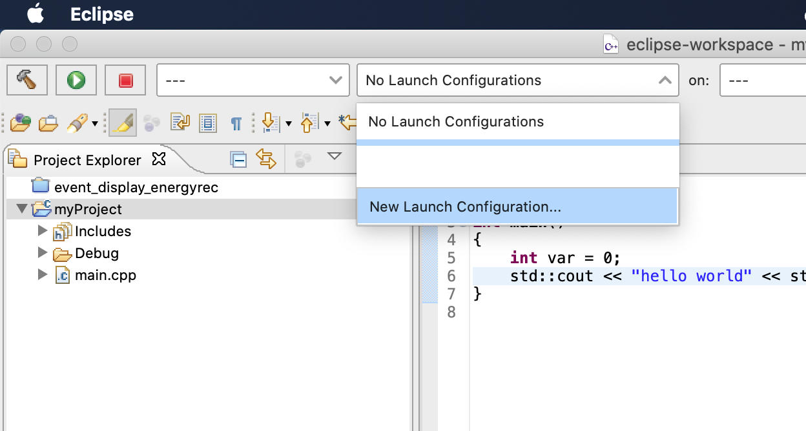
Building and Running
To Run a project for the first time:
Add New Launch Configuration

Slide 45
Building and Running
Launch mode: Run/Debug
Launch Config Type: C/C++ Application

Slide 46
Building and Running
Name: anything
Project: Name of project (auto filled)
C/C++ Application: Debug/<project_name>
Now you can click Run (the green play button icon)

Slide 47


Exercise
In Eclipse make a program that:
Prompts the user for 3 coordinates $r,φ,θ$
Converts these spherical coordinates into Cartesian coordinates $x,y,z$
Print the results out to 2 decimal places
$$x=r\sin{θ}\cos{φ}$$
$$y=r\sin{θ}\sin{φ}$$
$$z=r\cos{θ}$$

